Slide 1
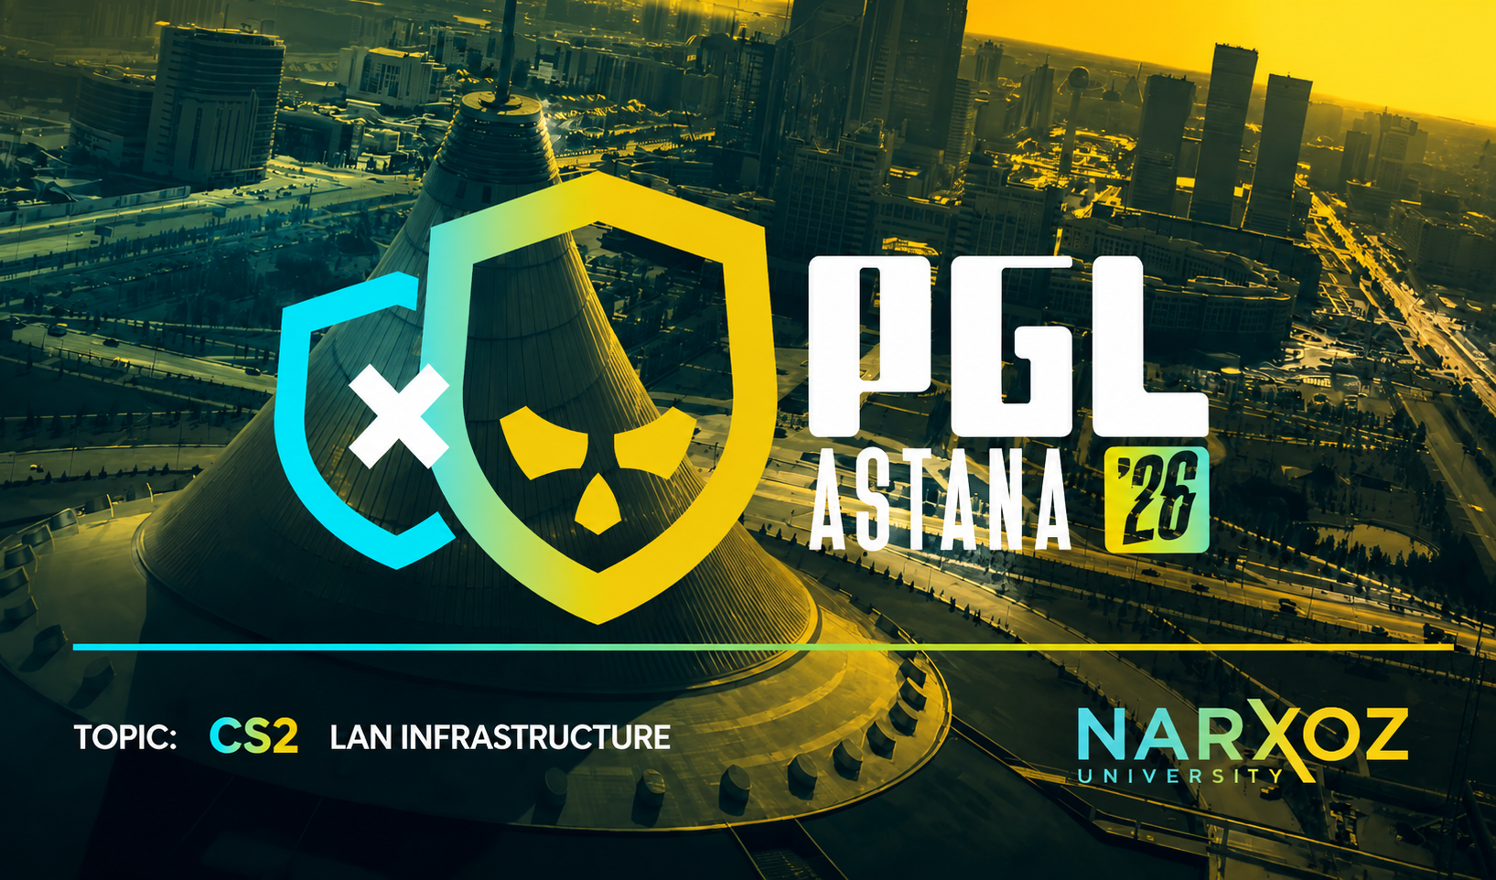

Topic: CS2 LAN Infrastructure
Student: Kamaliyev Tamerlan

Slide 2
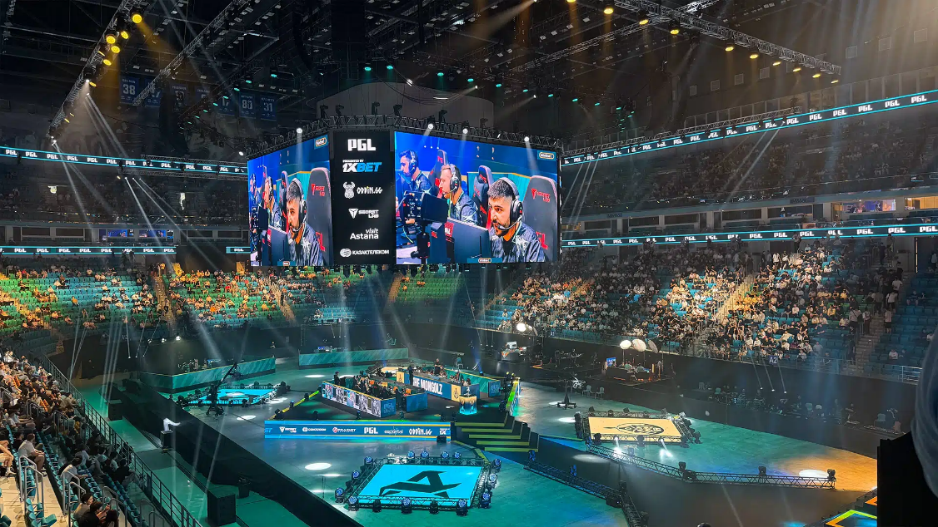


PGL Astana
This project was inspired by PGL Astana, one of the largest CS2 esports tournaments. The goal was to design a realistic tournament network infrastructure that supports players, administrators, casters, spectators, and game servers.

Slide 3
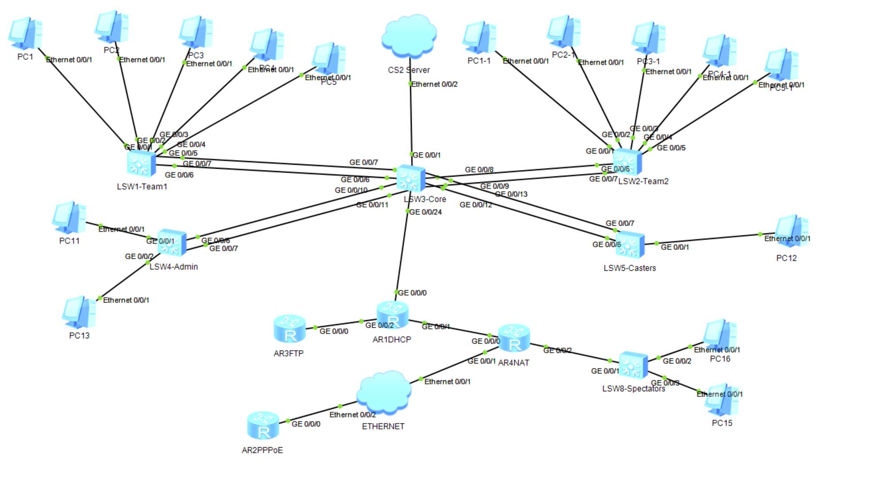
Topology
The network was designed using a hierarchical topology with a central Core Switch. Separate VLANs were created for players, administrators, casters, spectators, and servers to simplify management and improve security.

Slide 4
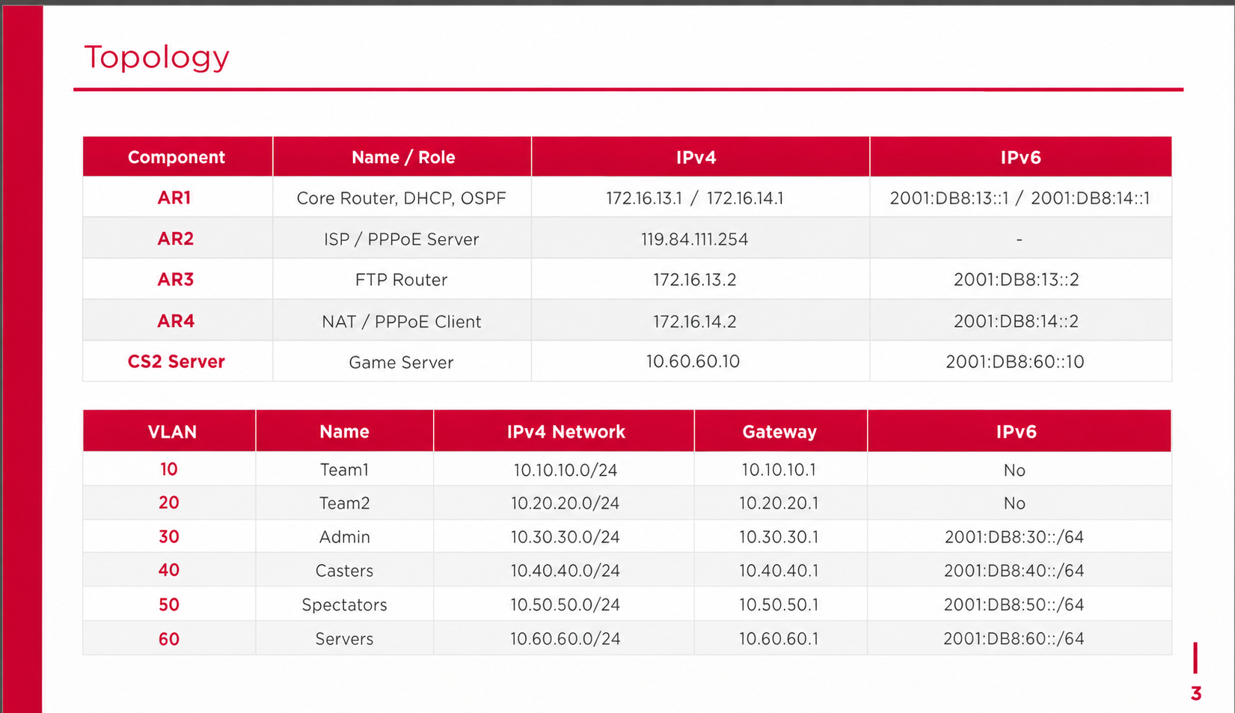
Topology

Slide 5
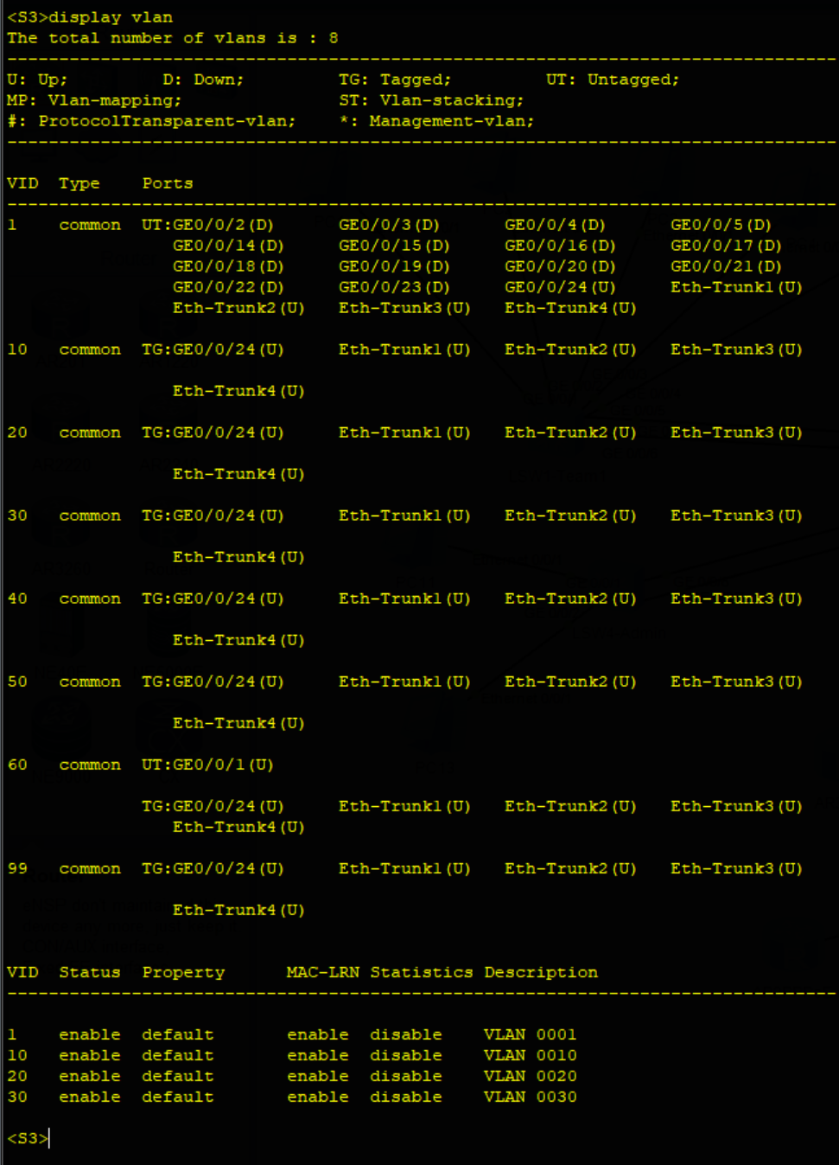
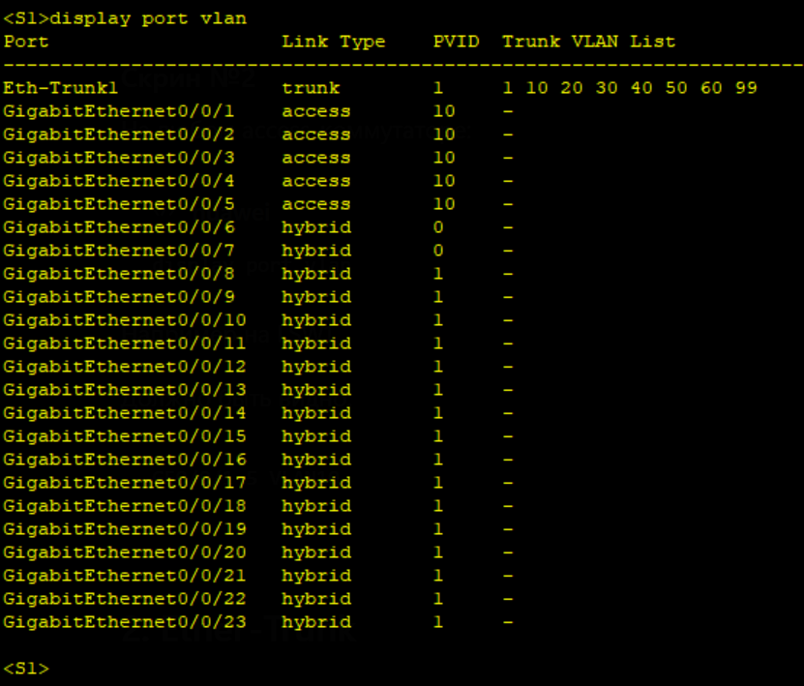
VLAN
VLAN segmentation was implemented to isolate different groups of users and services. This reduces broadcast traffic and improves overall network security.

Slide 6
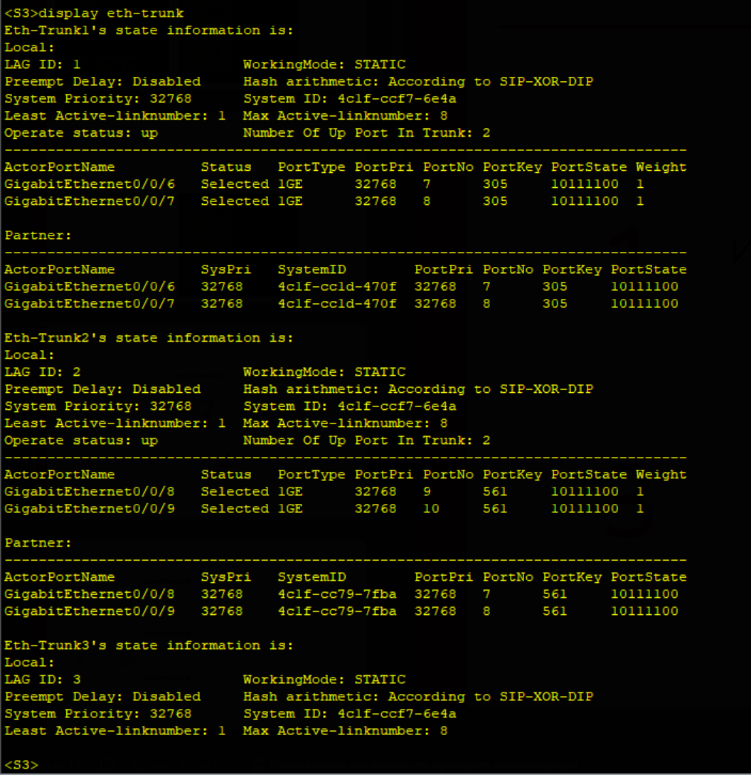
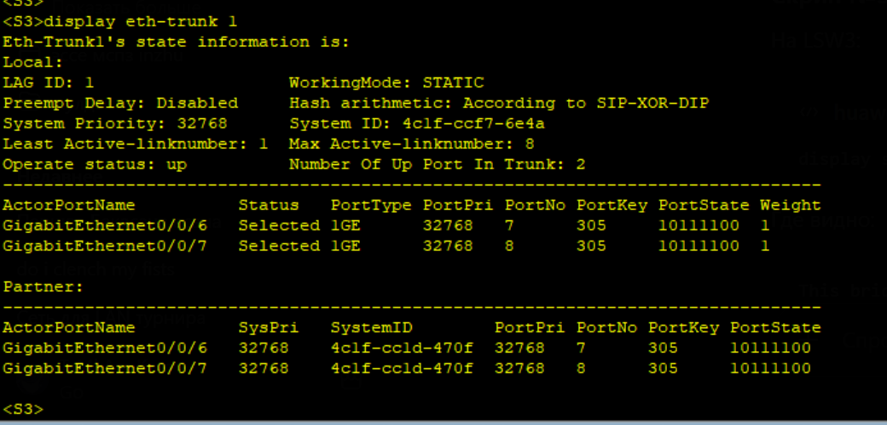
Ether-Trunk
Ether-Trunk was configured between switches to increase bandwidth and provide link redundancy. If one physical connection fails, traffic continues through the remaining links.

Slide 7
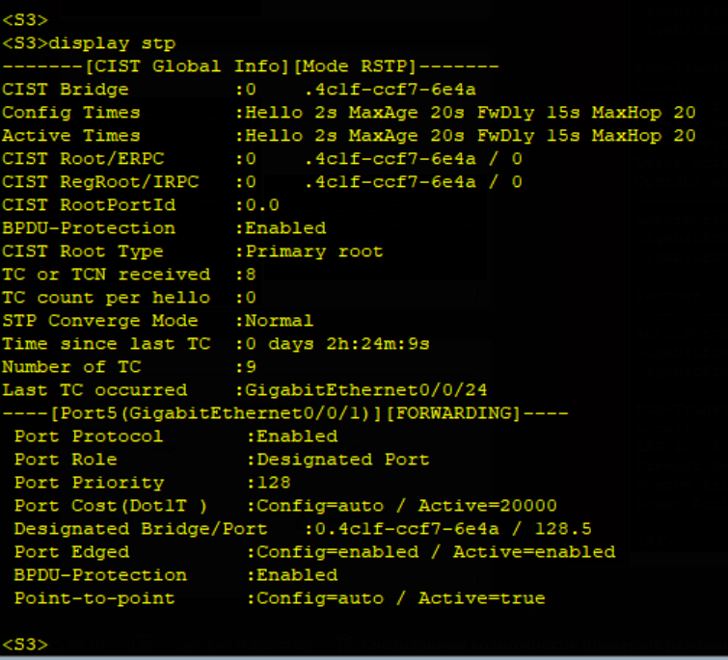
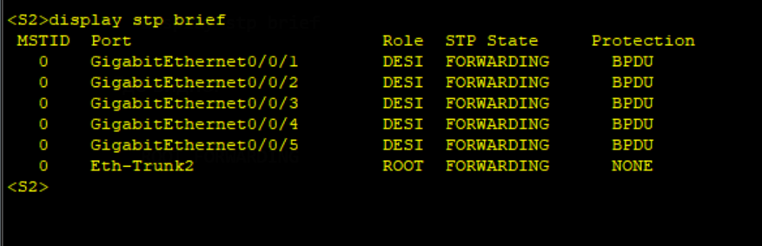
RSTP
RSTP was deployed to prevent Layer 2 loops and ensure stable network operation. The Core Switch was configured as the root bridge for optimal path selection.

Slide 8
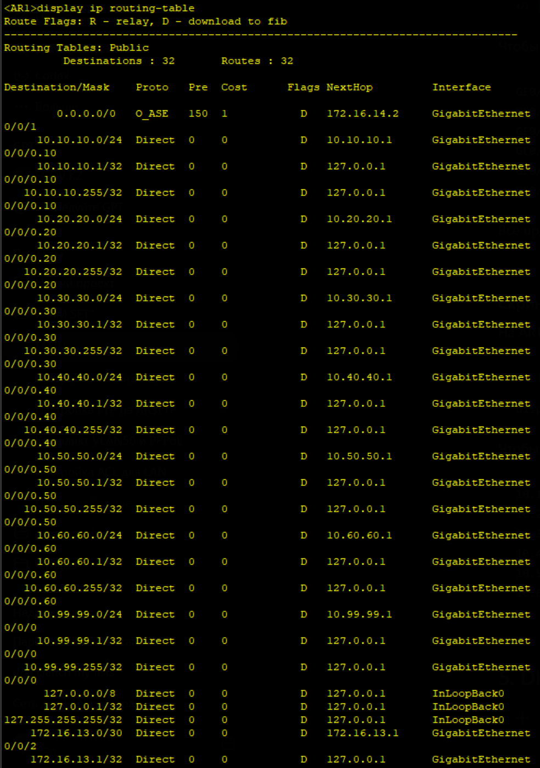
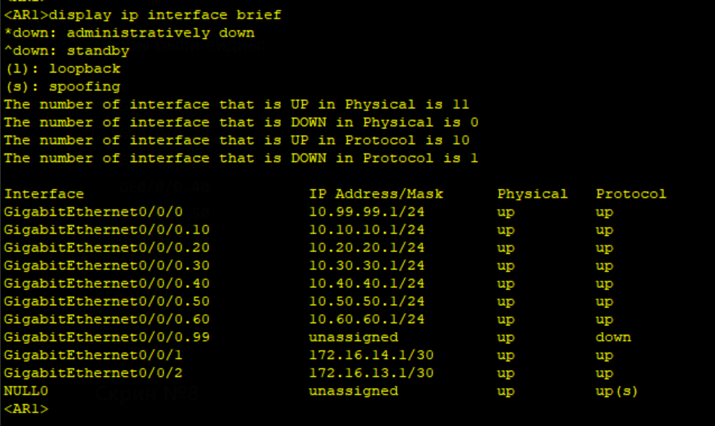
Router-on-a-Stick
Inter-VLAN routing was implemented on AR1 using Router-on-a-Stick technology. This allows devices from different VLANs to communicate through a single physical interface.

Slide 9
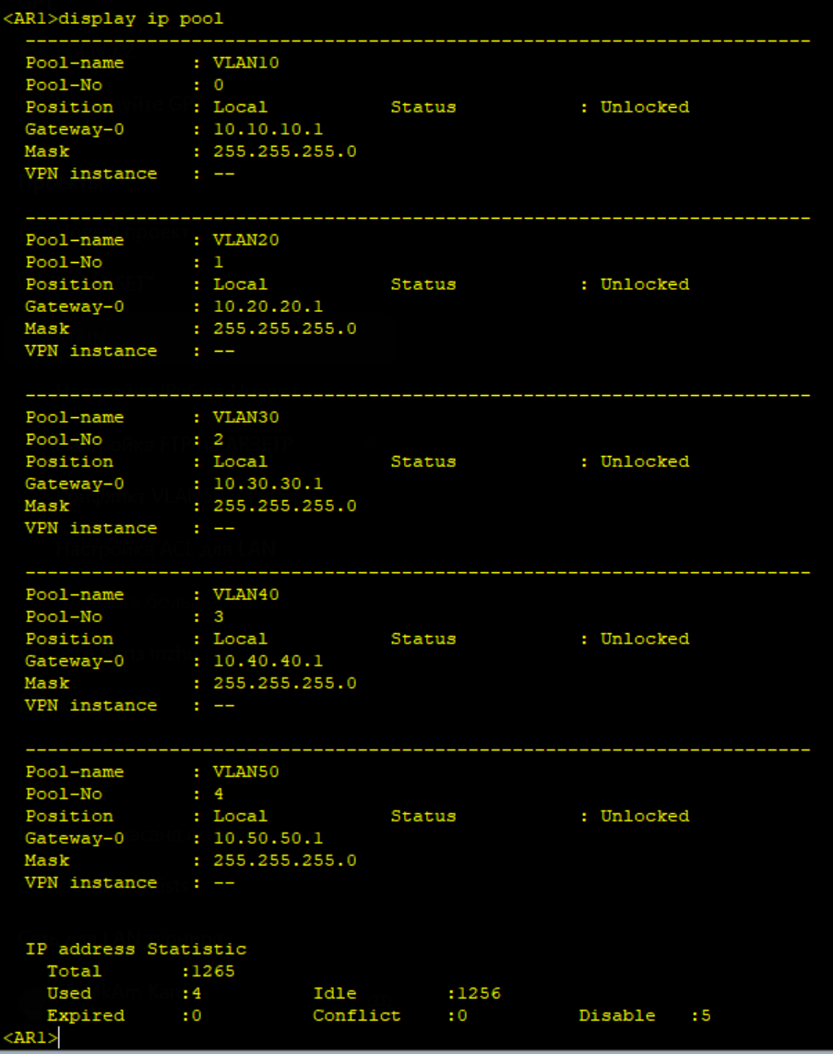
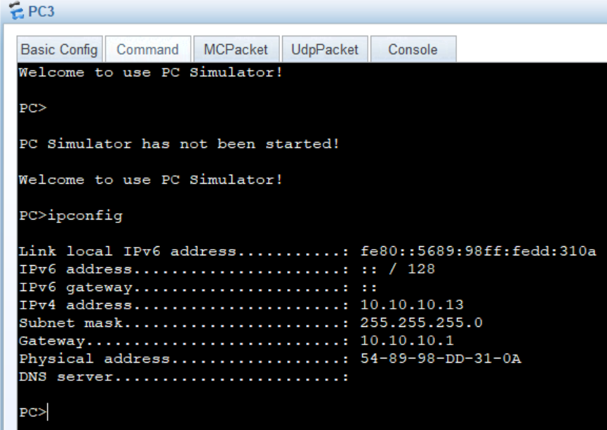
DHCP
DHCP was configured to automatically provide IP addresses and network parameters to clients. This simplifies deployment and reduces manual configuration.

Slide 10
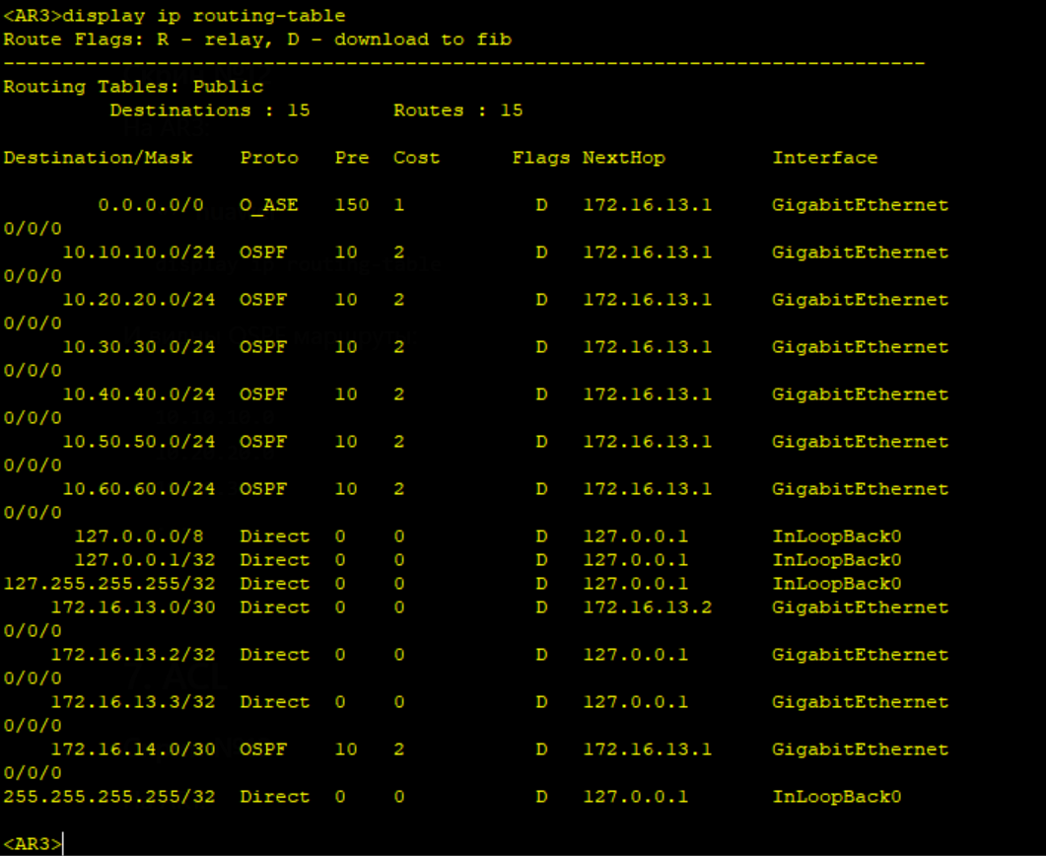
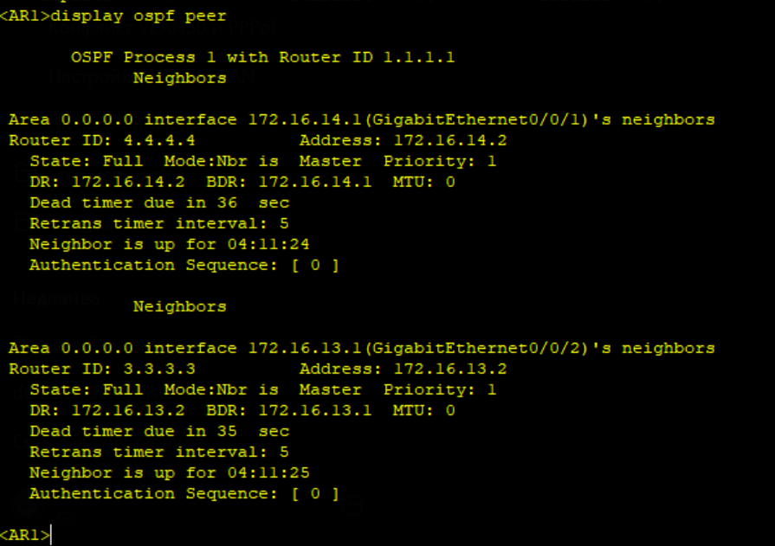
OSPF
OSPF was implemented to dynamically exchange routes between routers. This removes the need for static routing and allows the network to adapt automatically.

Slide 11
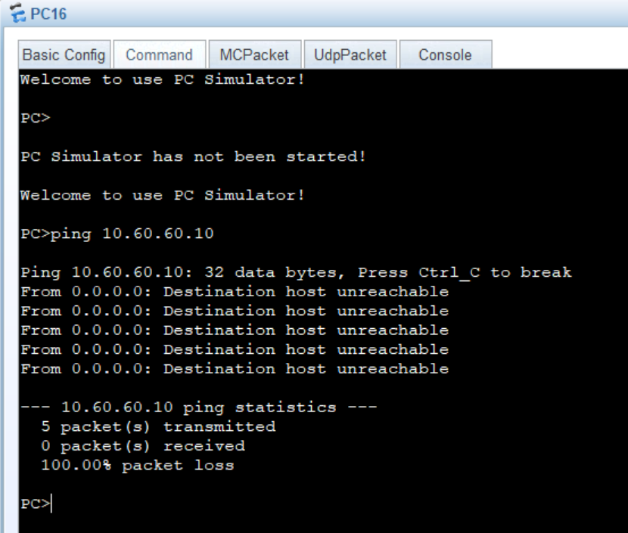
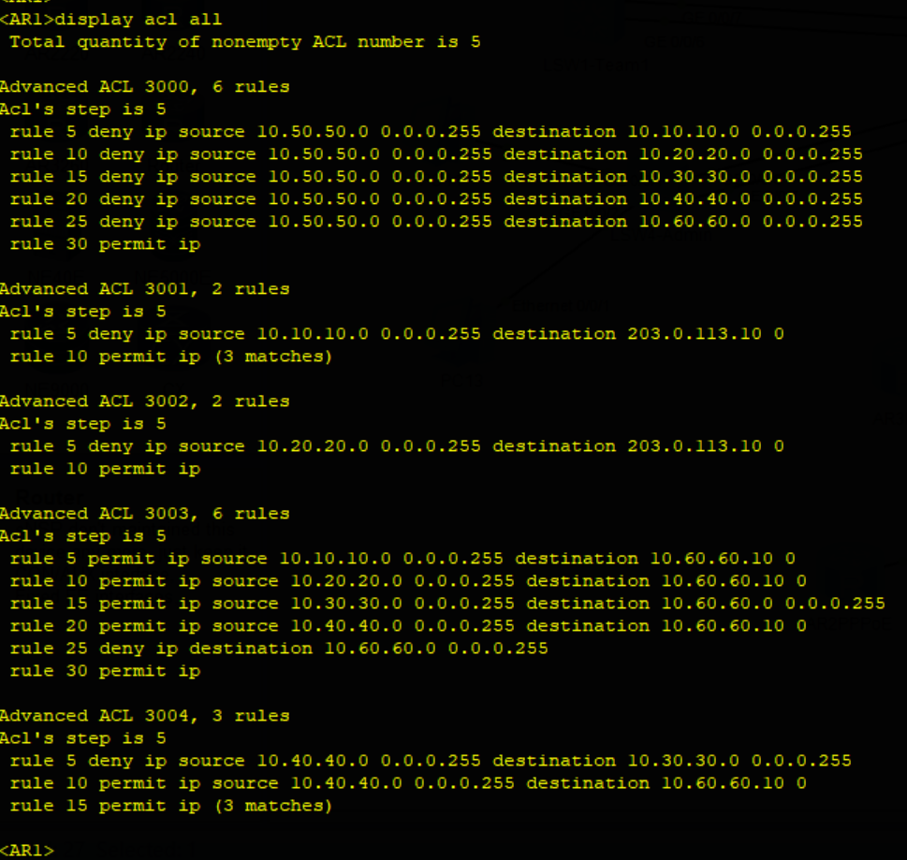
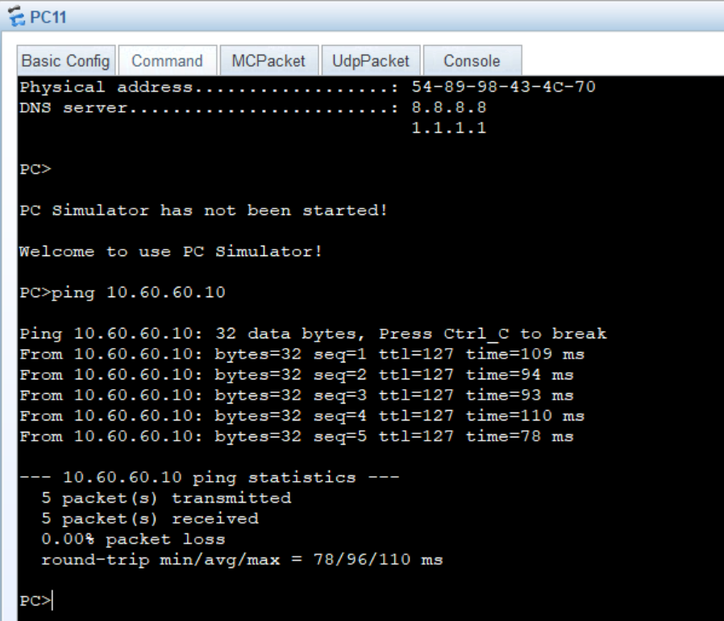
ACL
Access Control Lists were configured to enforce security policies. User access to network resources is controlled according to their role within the tournament infrastructure.

Slide 12
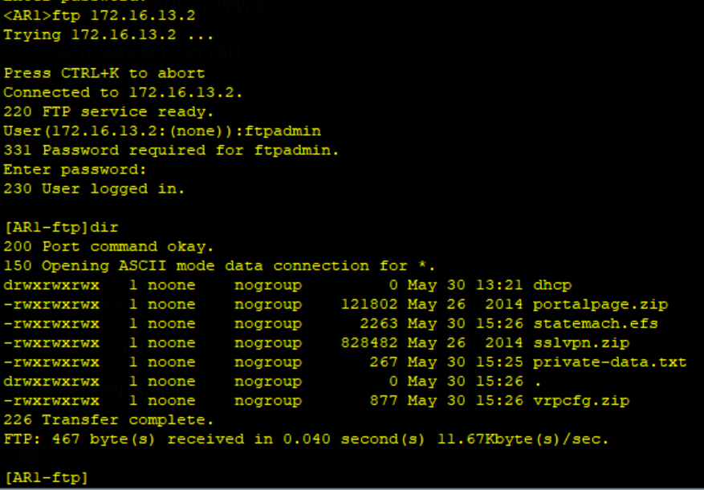
FTP
An FTP server was deployed on AR3 to store configuration backups and project files. Centralized storage simplifies administration and recovery procedures.

Slide 13
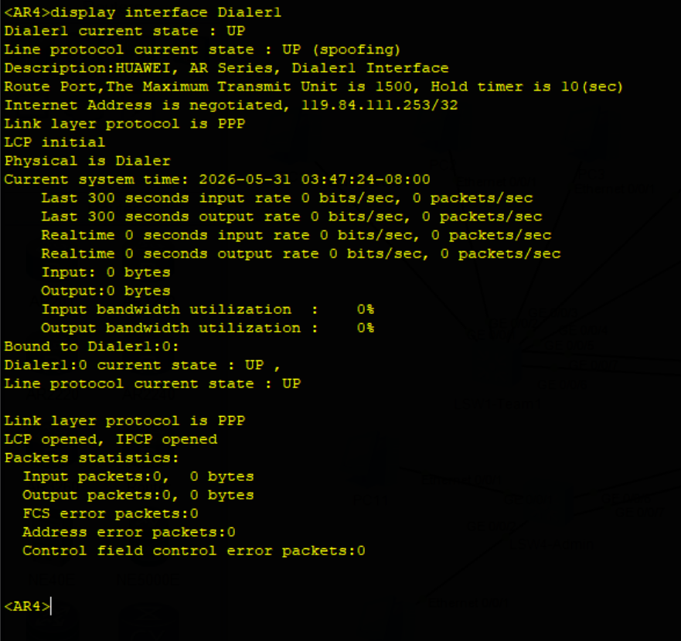
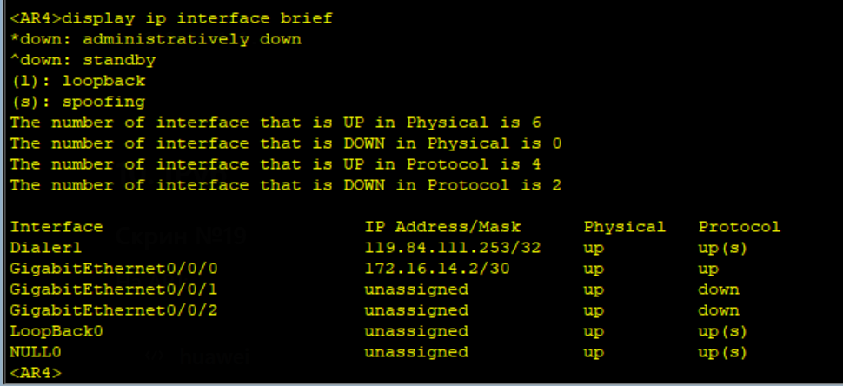
PPPoE
PPPoE was configured to simulate an Internet Service Provider connection. AR4 establishes a client session and receives network parameters dynamically.

Slide 14
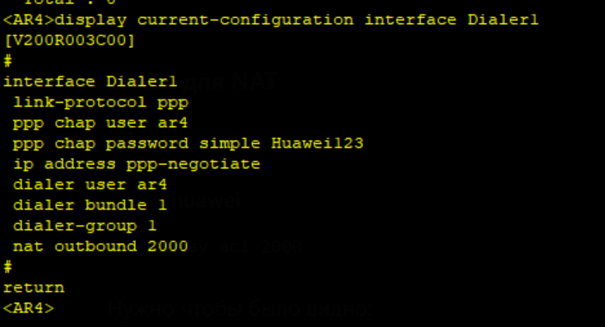
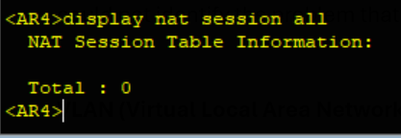
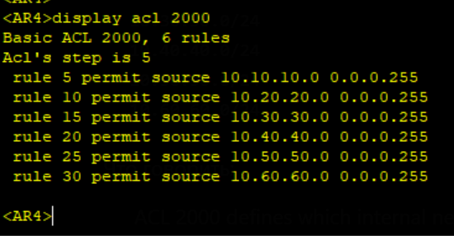
NAT
NAT was configured on AR4 to translate private VLAN addresses into a public PPPoE address, enabling internal networks to access external resources through a single WAN connection.

Slide 15
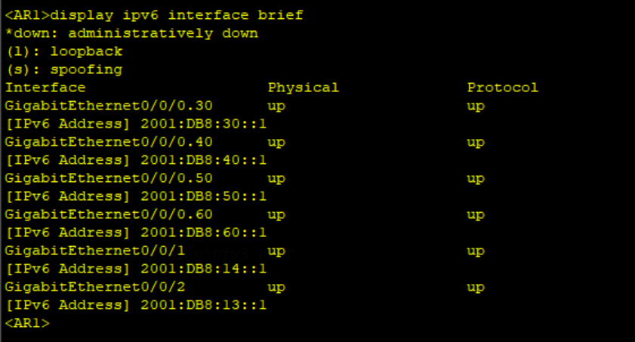
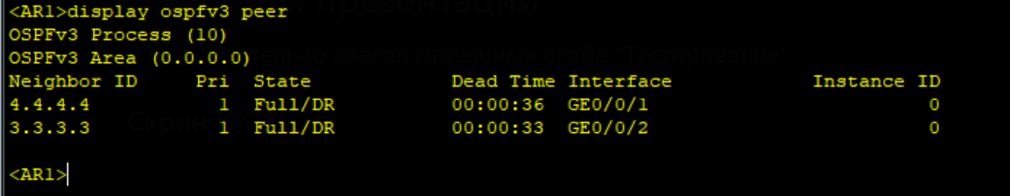
IPv6
IPv6 addressing and OSPFv3 routing were deployed alongside IPv4. This demonstrates support for modern networking standards and dual-stack operation.

Slide 16
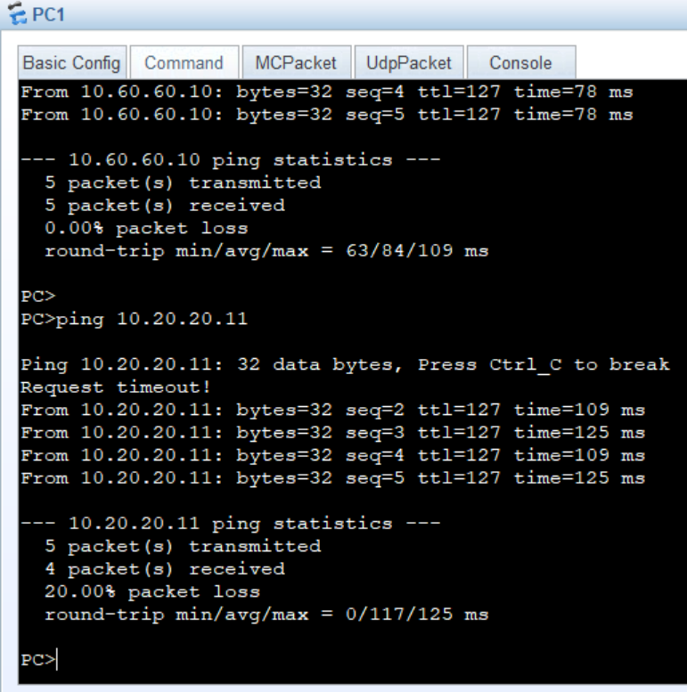
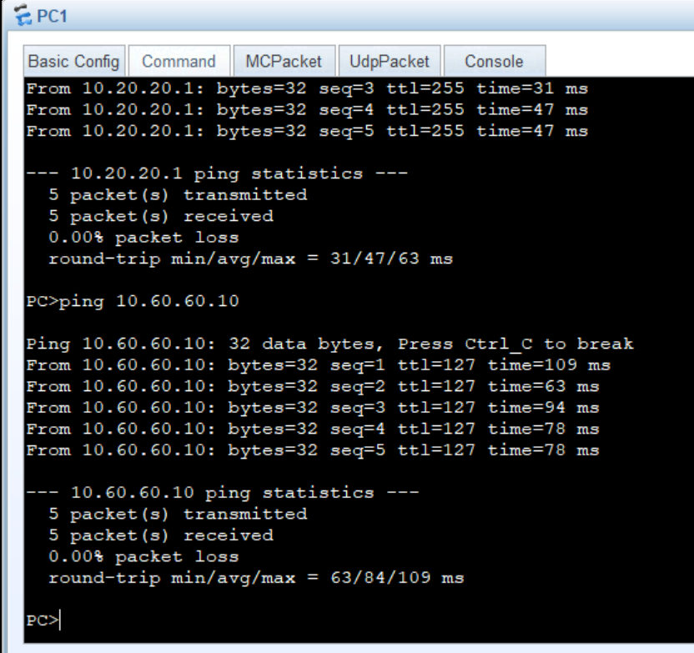
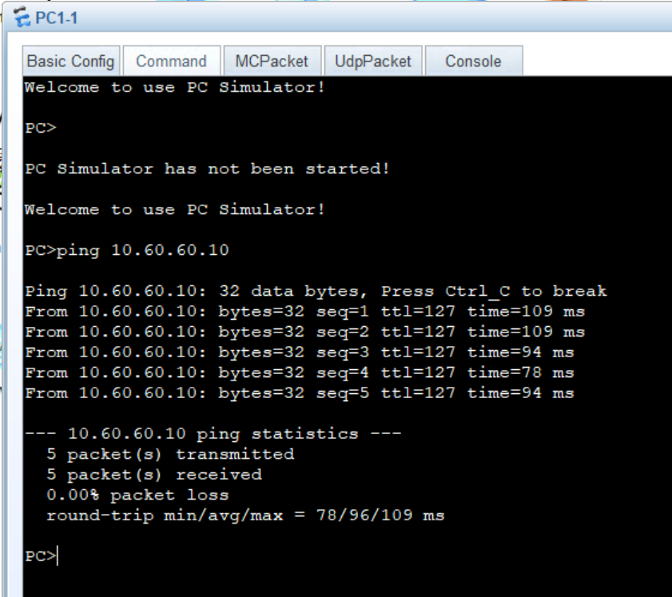
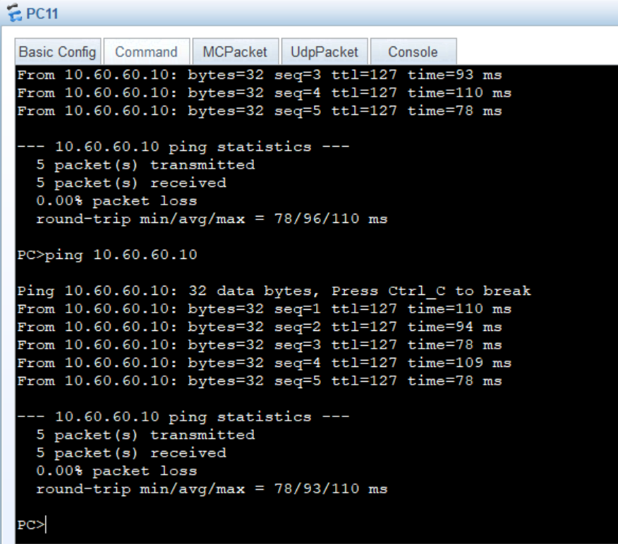
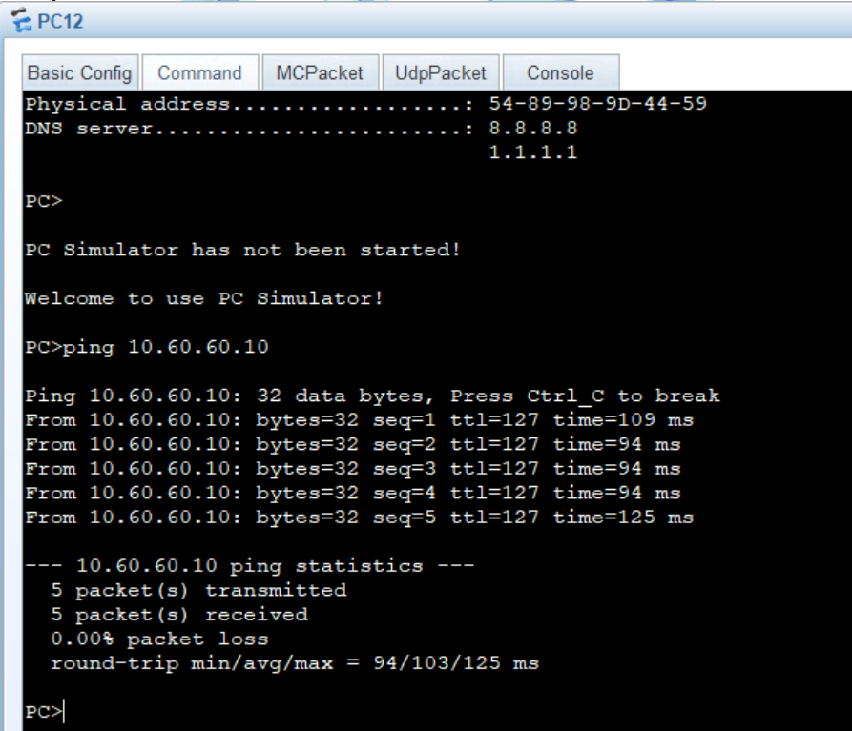
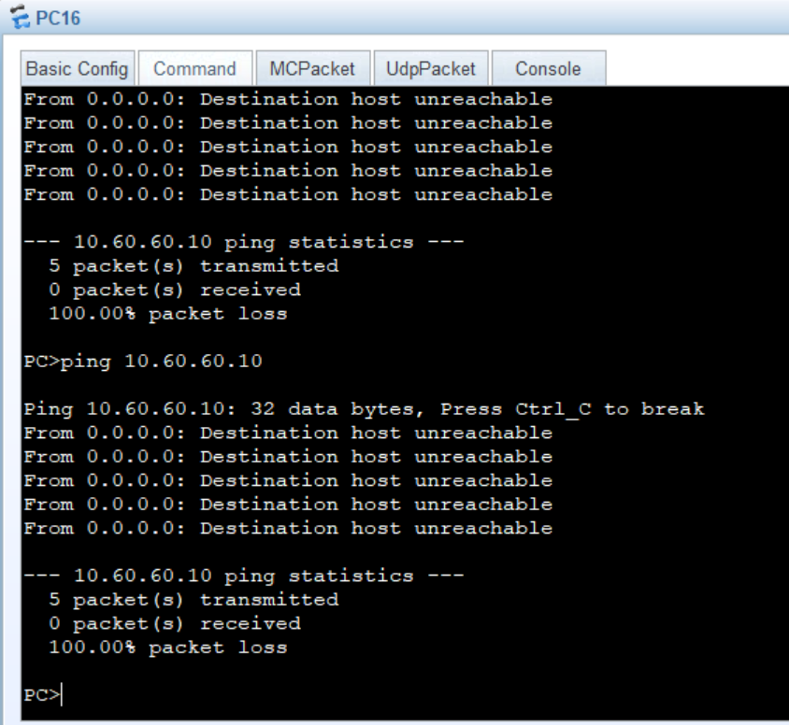
PING
Team1 → Team2
Team1 → CS2 Server
Team2 → CS2 Server
Admin → CS2 Server
Casters → CS2 Server
Spectators → CS2 Server

Slide 17
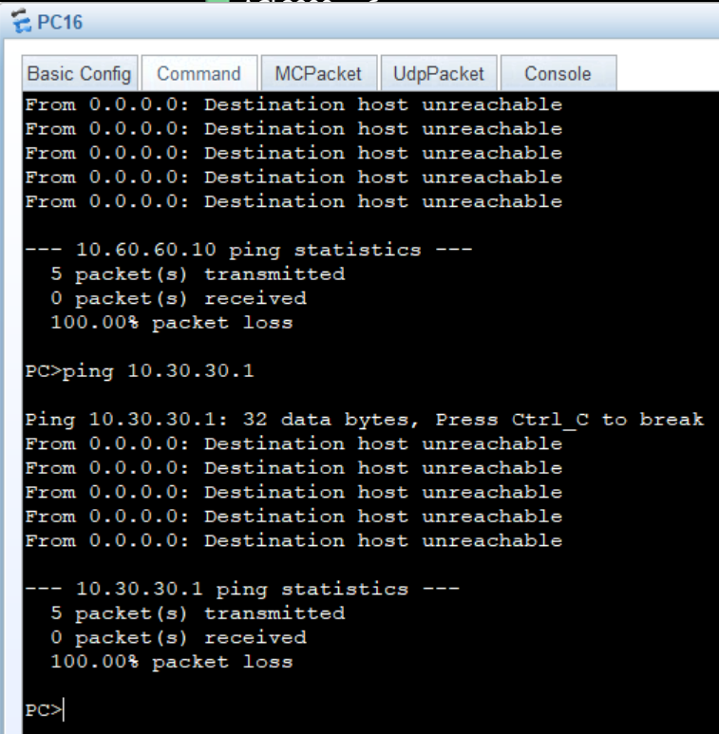
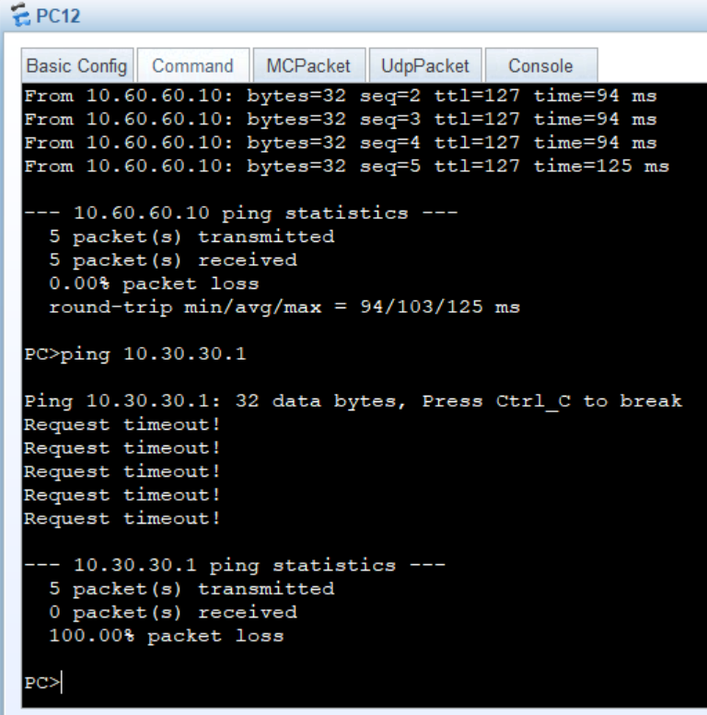
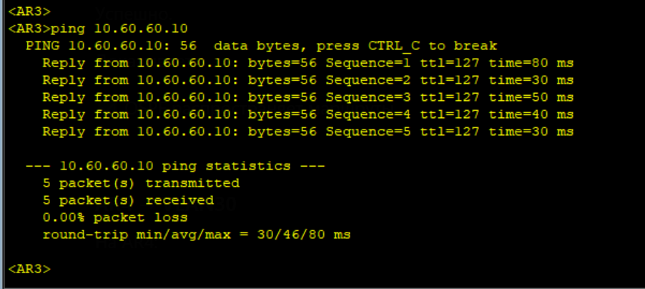
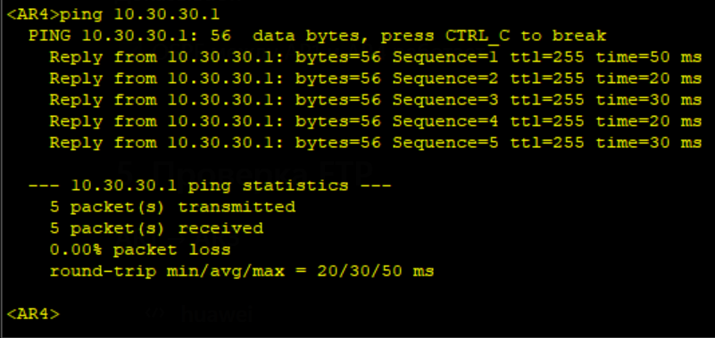
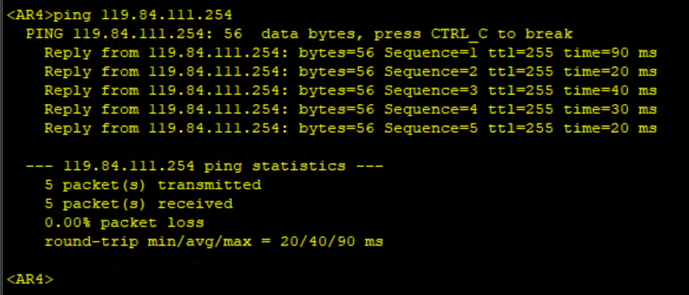
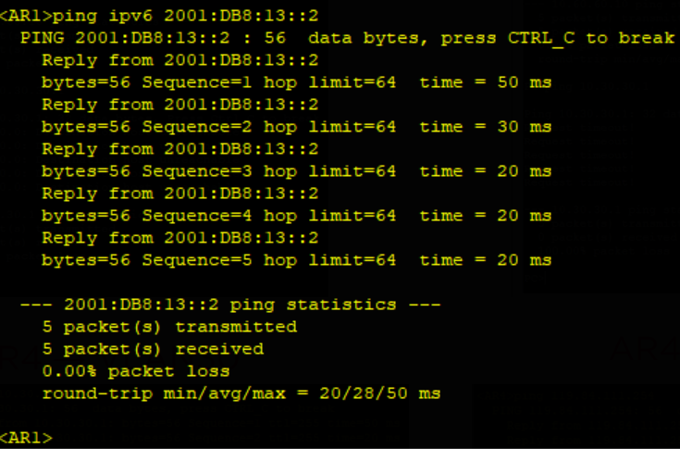
PING (ACL,OSPF, PPPoE,IPv6)
Spectators → Admin
Casters → Admin
AR3 → VLAN60 (OSPF)
OSPF distributes routes.
AR4 → Admin VLAN
AR4 → AR2(PPPoE)
AR1 → AR3(IPv6)
The OSPF between AR1 and AR4 works.

Slide 18
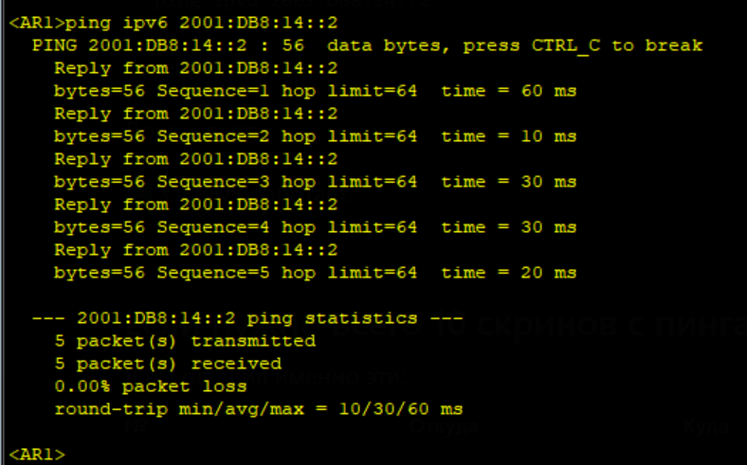
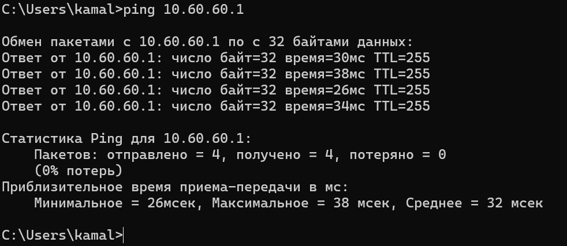
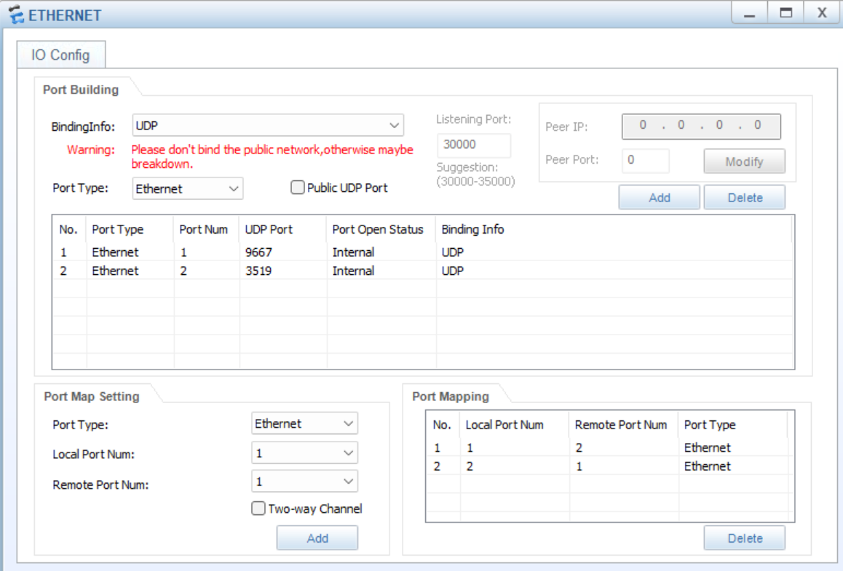
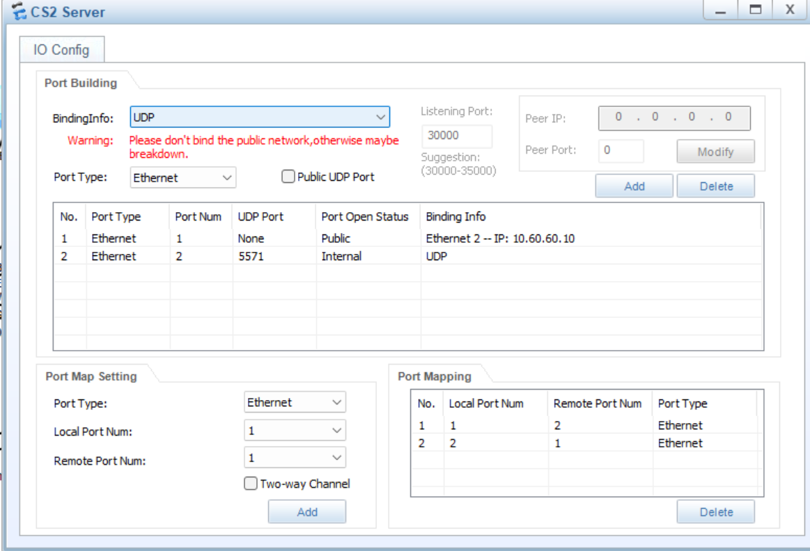
PING
AR1 → AR4(IPv6)
CS2 Server → Default Gateway (AR1)

Slide 19

PING

